Slide 1
Object Oriented Programming
Lec: 03

Slide 2
In Python, private attributes are declared with underscore as the prefix i.e single _ or double __
class Computer:
def __init__(self):
self.__maxprice = 900
def sell(self):
print("Selling Price: {}".format(self.__maxprice))
def setMaxPrice(self, price):
self.__maxprice = price
c = Computer()
c.sell()
# change the price
c.__maxprice = 1000
c.sell()
# using setter function
c.setMaxPrice(1000)
c.sell()

Slide 3
Example
class SecretString:
def __init__(self, plain_string, pass_phrase):
self.__plain_string = plain_string
self.__pass_phrase = "b"
def decrypt(self, pass_phrase):
if pass_phrase == self.__pass_phrase:
return self.__plain_string
else:
return’ ‘
s1=SecretString("hi","bye")
s1.decrypt("b")

Slide 4
Inheritance
Inheritance is the most famous, well-known, and over-used relationship in object-oriented programming.
The is-a relationship is formed by inheritance.
Inheritance is sort of like a family tree. For example, Ali’s grandfather last name was Haider, and his father inherited that name. Ali inherited it from him (along with blue eyes and a penchant for writing).
In object-oriented programming, inheriting features and behaviors from a person, one class can inherit attributes and methods from another class.

Slide 5
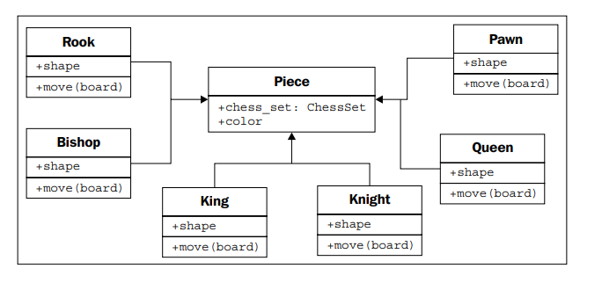
Cont.
In object-oriented programming, instead of inheriting features and behaviors from a person, one class can inherit attributes and methods from another class.

Slide 6
Cont.
For example, there are 32 chess pieces in our chess set, but there are only six different types of pieces (pawns, rooks, bishops, knights, king, and queen), each of which behaves differently when it is moved. All of these classes of piece have properties, such as color and the chess set they are part of, but they also have unique shapes when drawn on the chess board, and make different moves.
We can implement this by creating a dummy move method on the Piece class. The subclasses can then override this method with a more specific implementation.

Slide 7
Cont.
Inheritance is a very powerful tool for extending behavior. It is also one of the most marketable advancements of object-oriented programming.
Inheritance allows us to define a class that inherits all the methods and properties from another class. The most important use of inheritance in is code reusability
Parent class is the class being inherited from, also called base class.
Child class is the class that inherits from another class, also called derived class.
* In java extend keyword is used to implement inheritance.

Slide 8
Example
# Base class
class Vehicle:
def Vehicle_info(self):
print('Inside Vehicle class')
# Child class
class Car(Vehicle):
def car_info(self):
print('Inside Car class')
# Create object of Car
car = Car()
# access Vehicle's info using car object
car.Vehicle_info()
car.car_info()

Slide 9
Multiple inheritance
Object-oriented design can also feature such multiple inheritance, which allows a subclass to inherit functionality from multiple parent classes.
It can be used to create objects that have two distinct sets of behaviors. For example, an object designed to connect to a scanner and send a fax of the scanned document might be created by inheriting from two separate scanner and faxer objects.
Programming languages (most notably, Java) strictly prohibit it.

Slide 10
Example
class Person:
def person_info(self, name, age):
print('Inside Person class')
print('Name:', name, 'Age:', age)
# Parent class 2
class Company:
def company_info(self, company_name, location):
print('Inside Company class')
print('Name:', company_name, 'location:', location)
# Child class
class Employee(Person, Company):
def Employee_info(self, salary, skill):
print('Inside Employee class')
print('Salary:', salary, 'Skill:', skill)
# Create object of Employee
emp = Employee()
# access data
emp.person_info('Jessa', 28)
emp.company_info('Google', 'Atlanta')
emp.Employee_info(12000, 'Machine Learning’)

